Slide 1
QUIZING CAMEOS
Author: Md. Rakib Mia
ID:11708016
Session: 2016-17
Dept. of CSE
Comilla University
Supervisor: NAYAN BANIK
Lecturer
Dept. of CSE
Comilla University

Slide 2
Presentation Outline:
Introduction
Related Works
Motivation
Objectives
Features
Architecture
Result
Conclusion and Limitation
Reference

Slide 3
Introduction:
As much we know that everything is now computerized. Students will love to be the part of this online examination system.
A large number of participants, with instant results of online quiz, a better overview, admin can able to randomize the questions and set a timer.
That all without the need of the classroom and paper teacher can take their exam’s, which saves our time and also move us one step forward to a digital country.

Slide 4
Motivation
The online quiz site engage students in a unique and fun way and connect them to the learning material.
Accessible from anywhere anytime.
Time space consuming
Easy way to connect teachers and seems like using advance technology.

Slide 5
Related Works:
Quizizz: Ankit and Deepak developed Quizizz in 2015. Over 10 million students use Quizizz, and half a billion questions are completed every month. Quizizz is used in one out of every two U.S. schools.
ClassMarker: ClassMarker is an easy-to-use, customized online testing solution for business, training, and educational evaluations. Tests and Quizzes are graded instantly, saving hours of paperwork.
EasyLAMS: It is a global corporation specializing in the development of online education technology. They offer a formal test, an educational course, a competitive quiz, an entertaining evaluation, and certification possibilities.

Slide 6
Objectives
Admin can update course, exam, examinee information. This system was required to complete the following tasks:
Contain all details information about a Quiz question.
Have information readily available and accessed by user.
Maintain updated information .
Admin can delete new data and update existing data that will show in user side.
User can only see exam data. They cannot insert or update exam data.

Slide 7
Features:
User friendly
Contains details about Quiz.
Contains all course data
Secured
Information updatable
Storage Maintainable
Quiz with timer
Instant result
Ranking system
Feedback anonymously

Slide 8
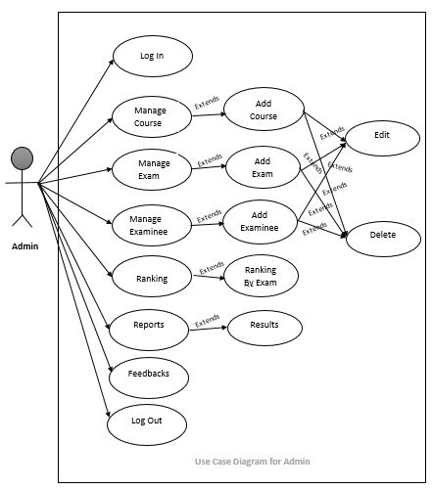
Admin use case:
AECHITECTURE

Slide 9
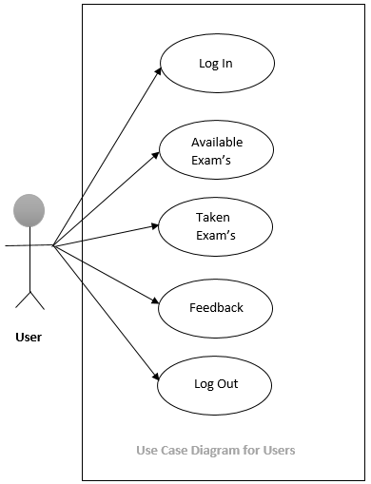
Students use case:

Slide 10
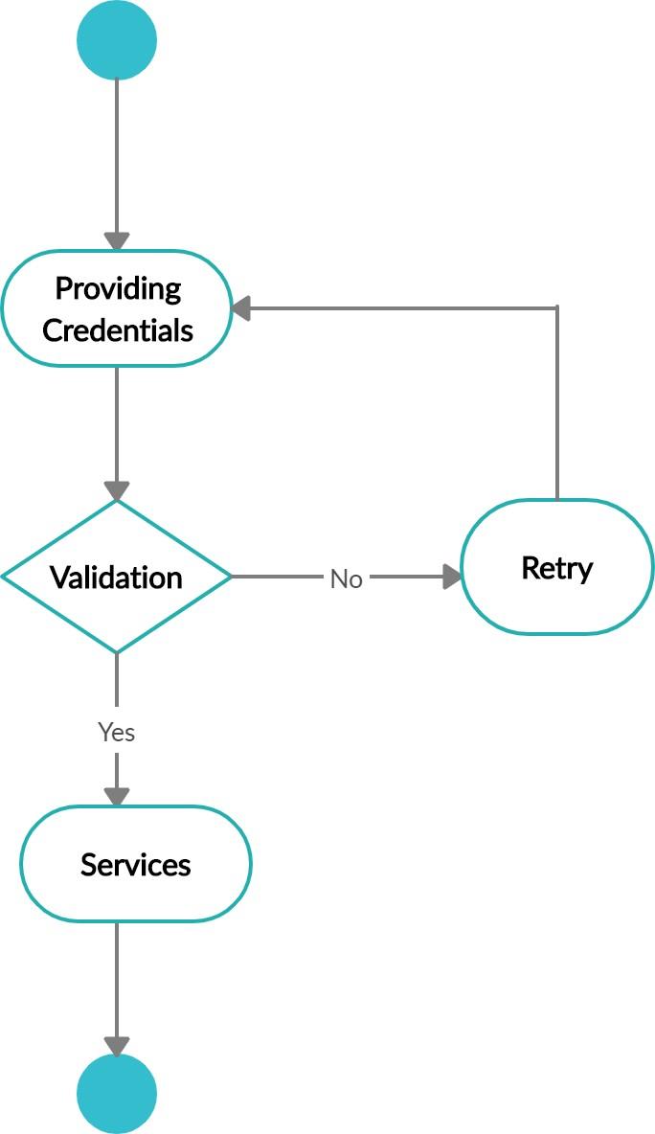
Login Process:

Slide 11
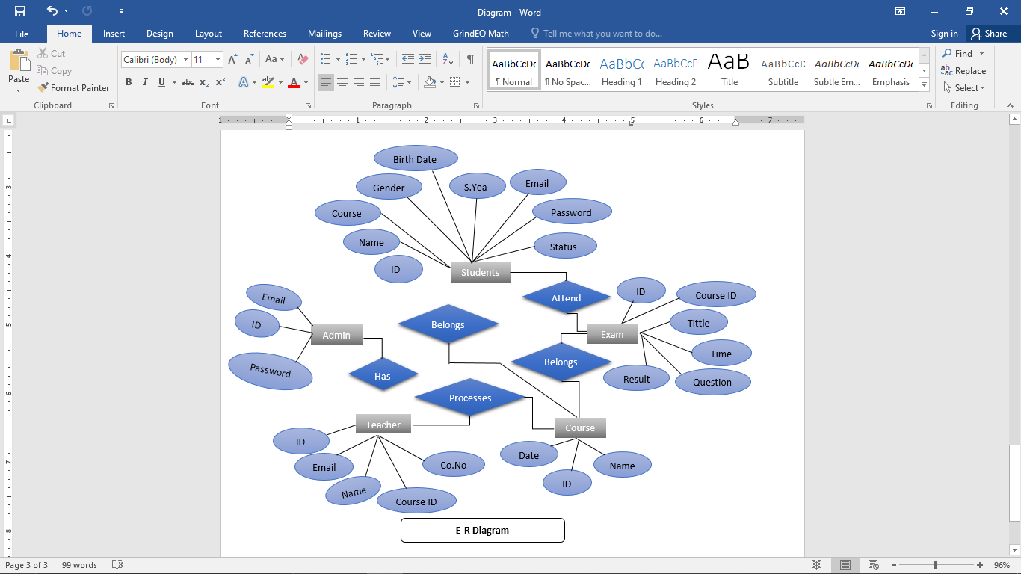
ER-Diagram:

Slide 12
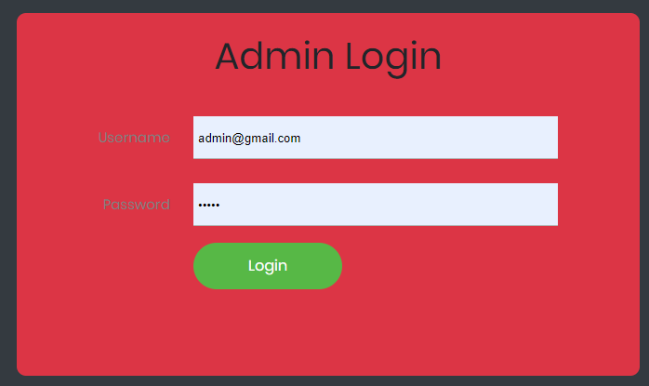
Result (Screen Shots)
Admin Login

Slide 13
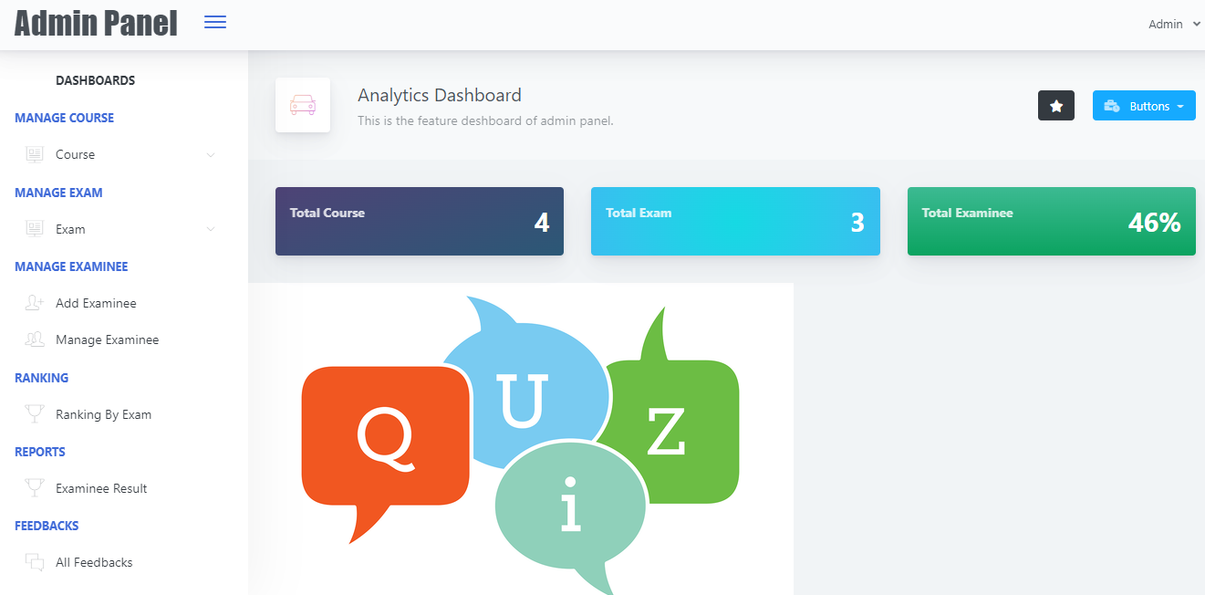
Admin Panel

Slide 14
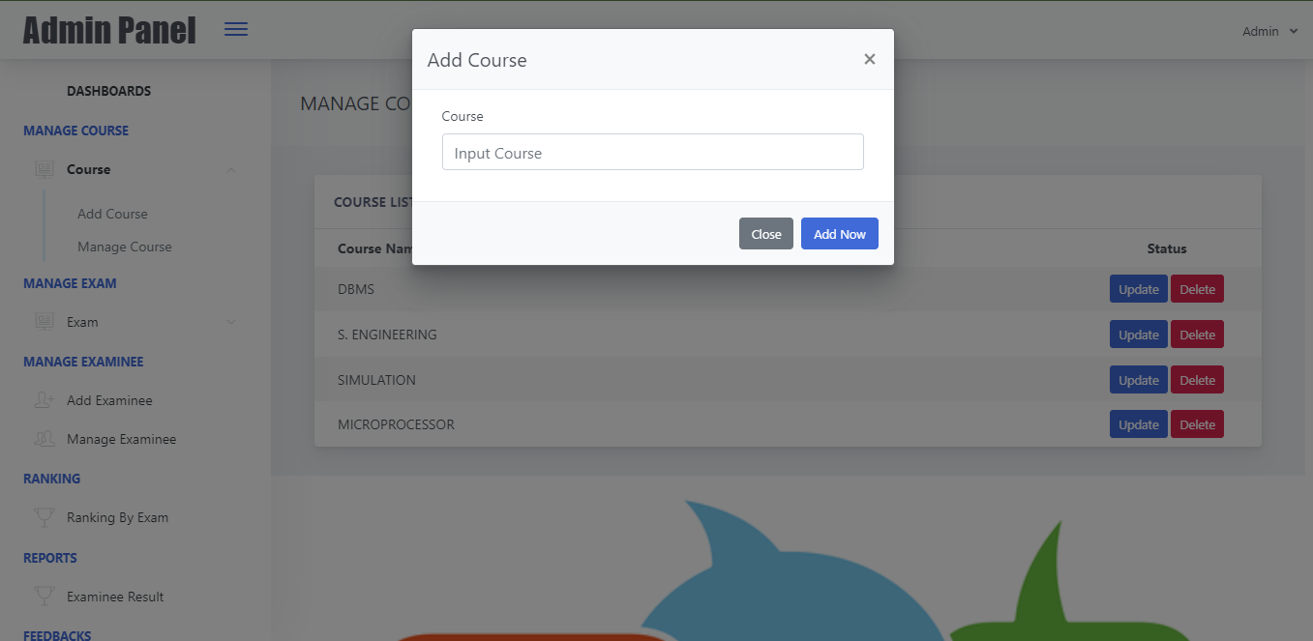
Add Course

Slide 15

Manage Course

Slide 16
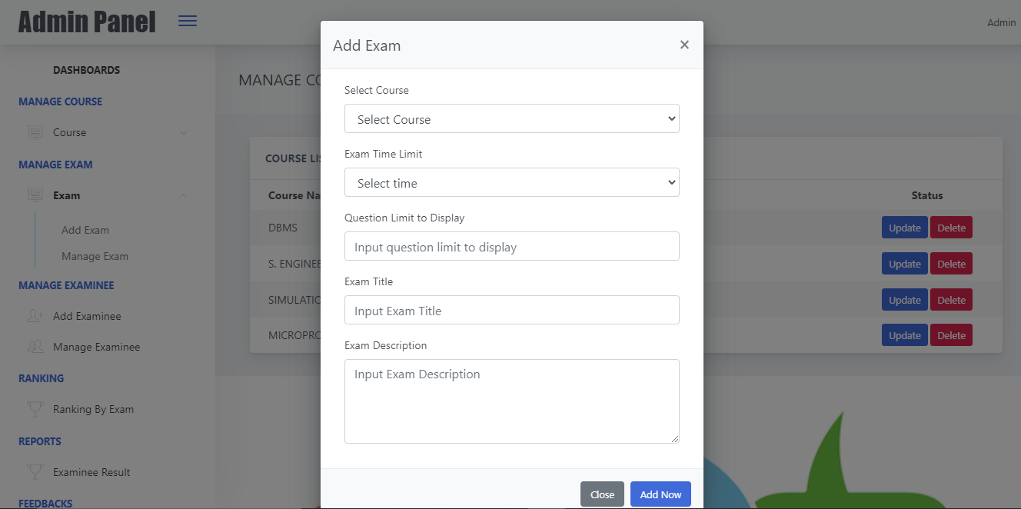
Add Exam

Slide 17
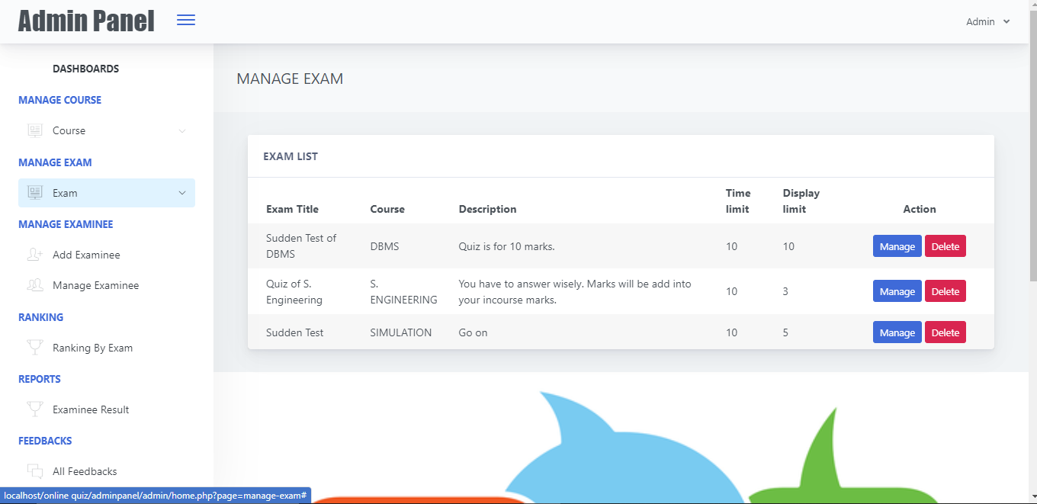
Manage Examination

Slide 18
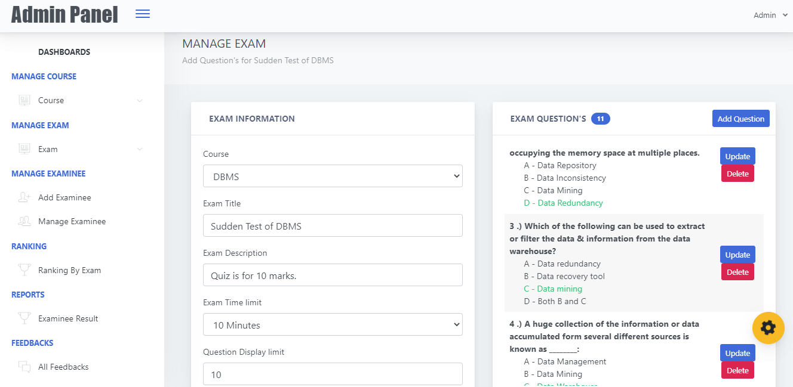
Exam Information

Slide 19
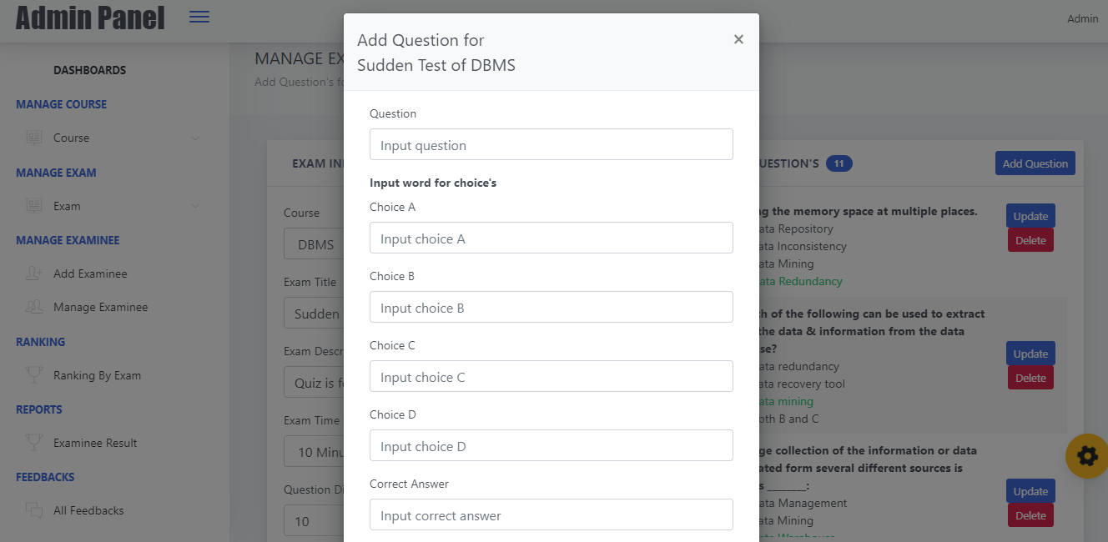
Add Exam Question

Slide 20
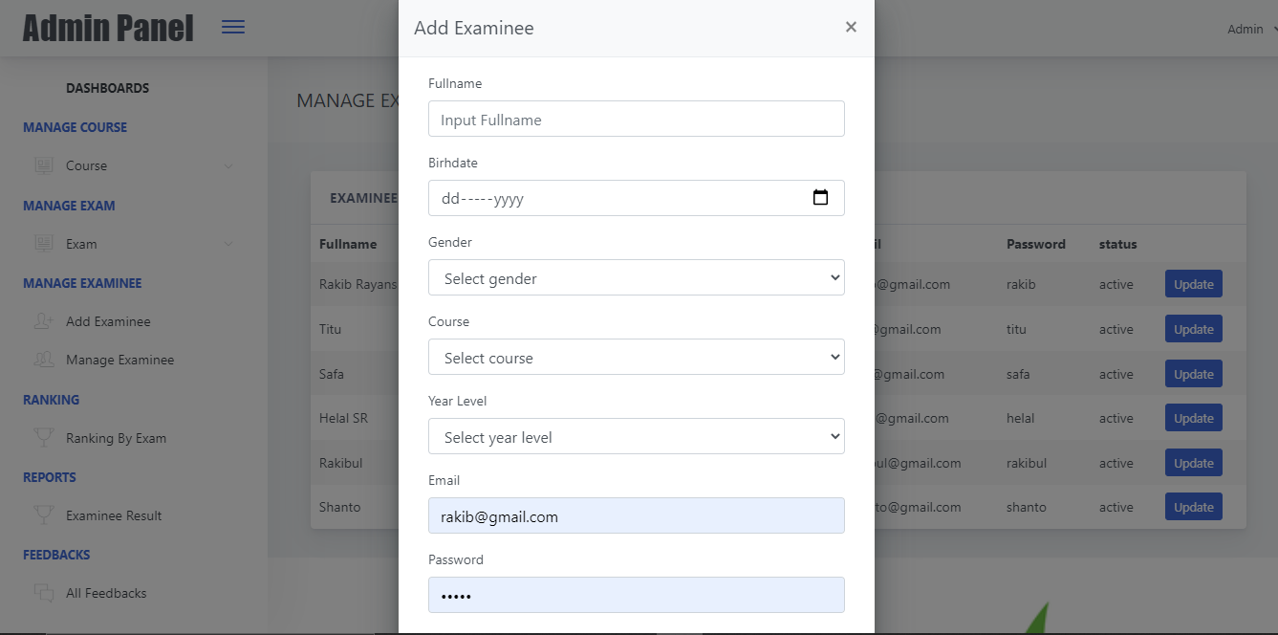
Add Students

Slide 21
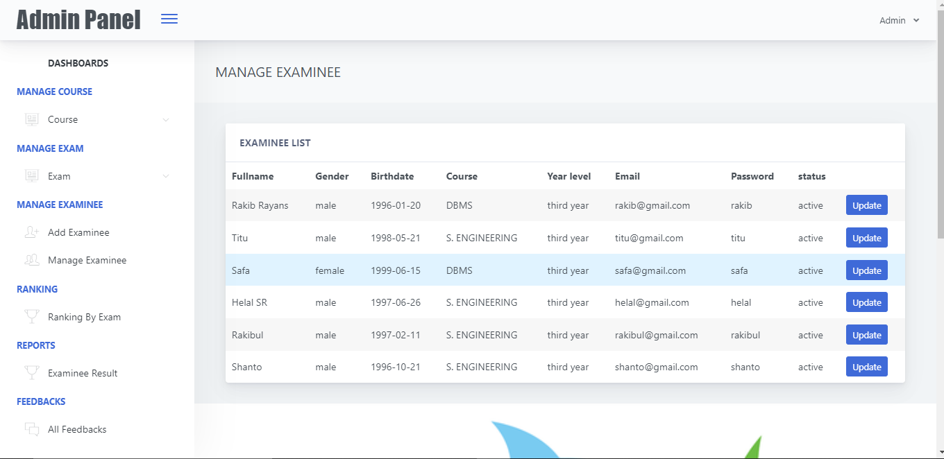
Manage Students Information

Slide 22
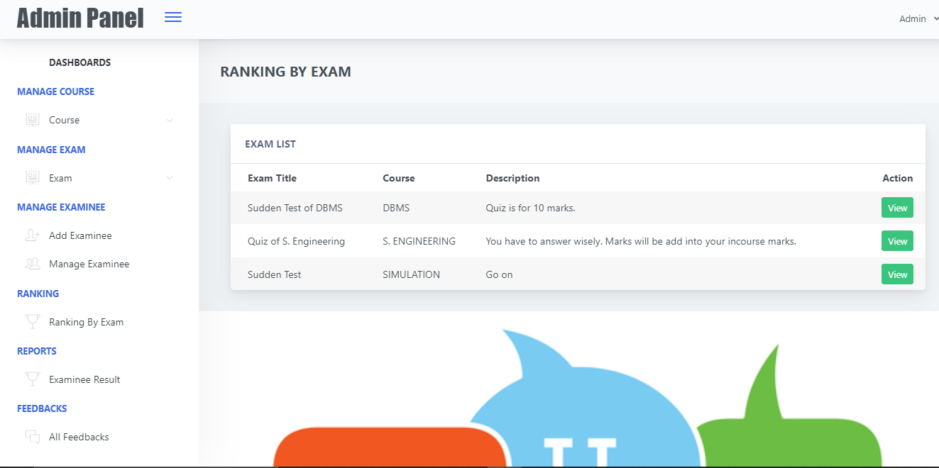
Course Wise Result List

Slide 23
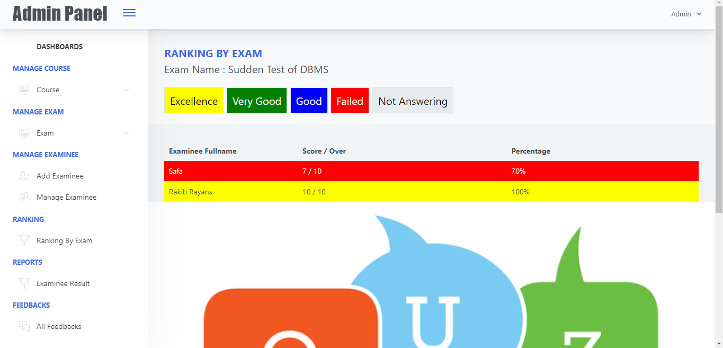
Students Ranking System

Slide 24
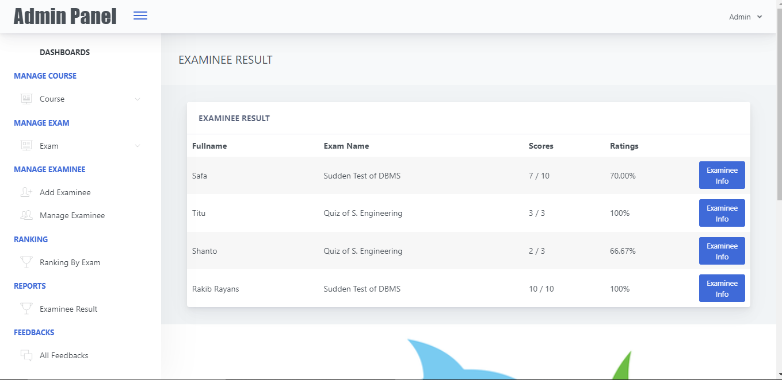
Students Result

Slide 25
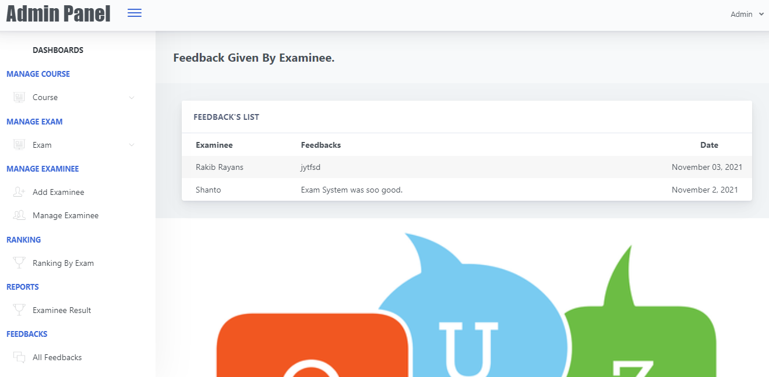
Feedback Panel

Slide 26
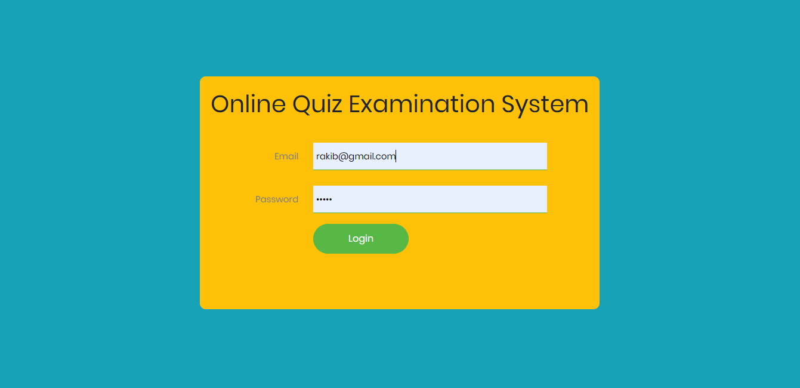
User Login Panel

Slide 27
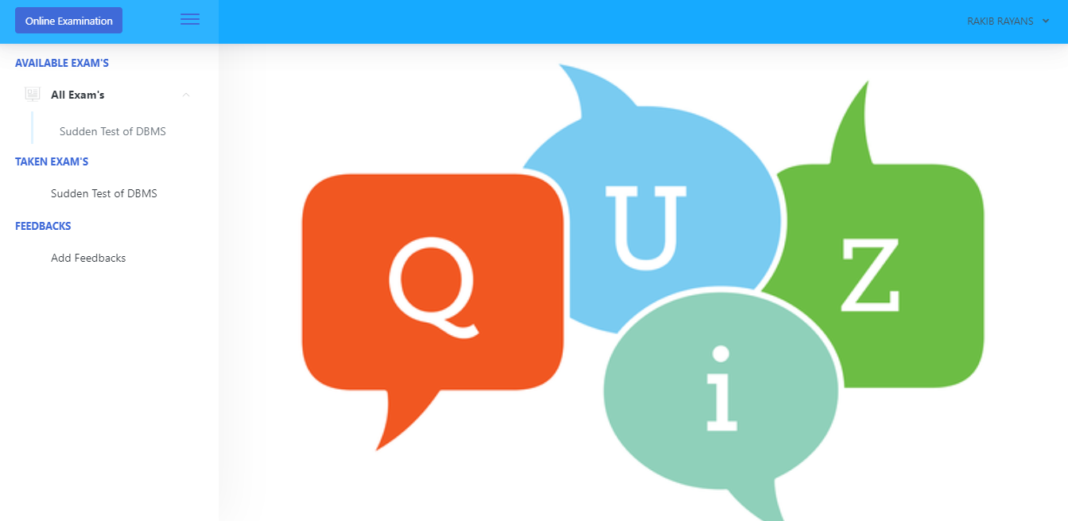
User Panel

Slide 28
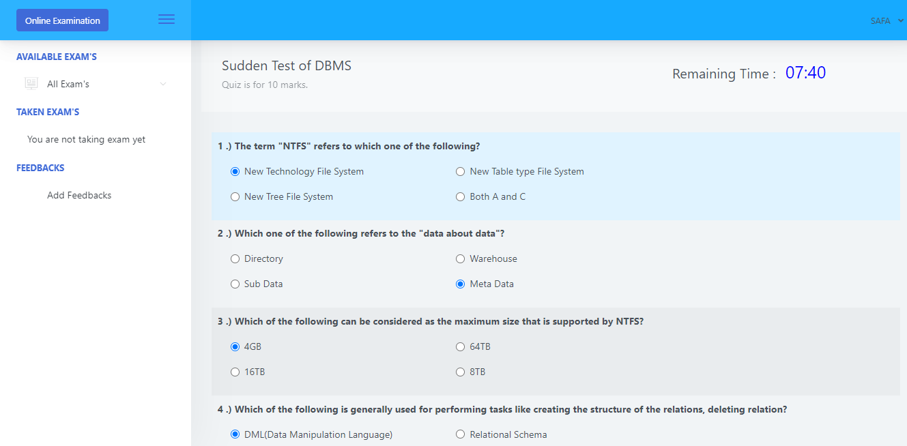
During Exam is Running

Slide 29
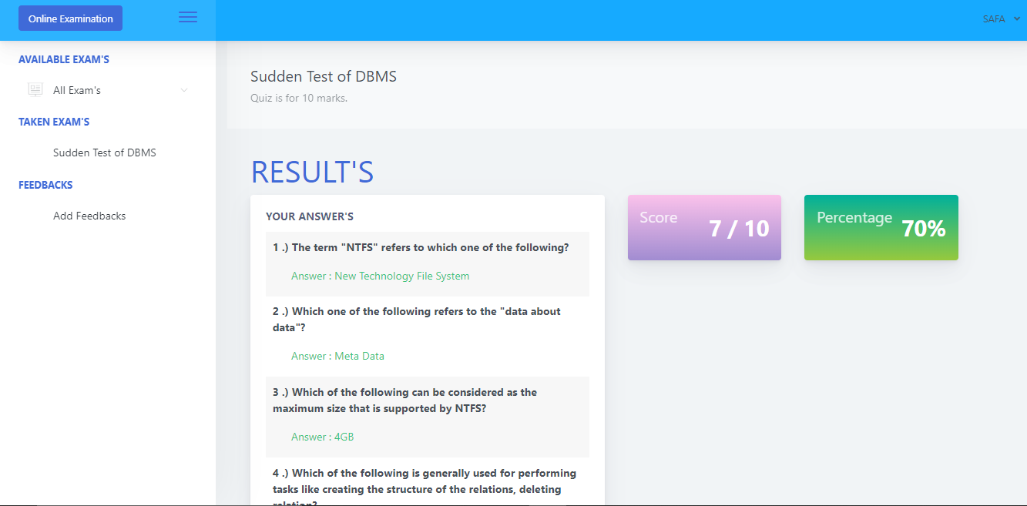
Instant Result Viewing Panel

Slide 30
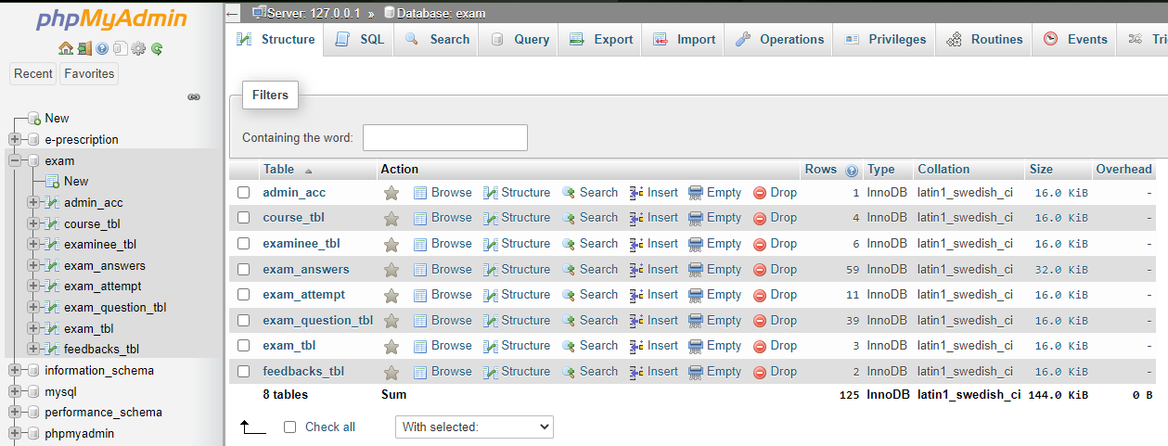
Database Tables:

Slide 31
Conclusion:
This online quiz system saves time as it allows large number of students to give the exam at a time and displays the results as the test gets over, so no need to wait for the result. Administrator has a privilege to create, modify and delete the course and its particular questions. User can login and give the test with his specific id, and can see the results as well.

Slide 32
Limitations:
Need high speed Internet connection.
Adding question one by one.
This site doesn’t create invitation link.
Result isn’t printable.

Slide 33
Future Work:
There are some features could be included in this project in the future to make the application more efficient and fully functioning.
Import questions and student information an excel file
Printed result
Questions could be saved as templates for future use
Students may be invited via a link
Strong Security

Slide 34
Reference
[1] Henry F. Korth S.Sudarshan. Book on “Database system concept”.
[2] Kajitori, K., Aoki, K., & Ito, S. (2014). Developing a Compact and Practical Online Quiz System. International Journal of Modern Education & Computer Science, 6(9).
[3] Chang, L. J., Yang, J. C., & Yu, F. Y. (2003). Development and evaluation of multiple competitive activities in a synchronous quiz game system. Innovations in Education and Teaching International, 40(1), 16-26.
[4] Tinoco, L. C., Barnette, N. D., & Fox, E. A. (1997, March). Online evaluation in WWW-based courseware. In Proceedings of the twenty-eighth SIGCSE technical symposium on Computer science education (pp. 194-198).
[5] Griff, E. R., & Matter, S. F. (2013). Evaluation of an adaptive online learning system. British Journal of Educational Technology, 44(1), 170-176.
[6] Juhaňák, L., Zounek, J., & Rohlíková, L. (2019). Using process mining to analyze students' quiz-taking behavior patterns in a learning management system. Computers in Human Behavior, 92, 496-506.
[7] Zannat, M. (2017). Online Quiz System (Doctoral dissertation, Stamford University Bangladesh).
[8] Kornepati, P. (2017). Online Quiz System (Doctoral dissertation, San Diego State University).
[9] Sarker, Z., & Rahman, M. (2007). Online intelligent quiz system (Doctoral dissertation, BRAC University).
[10] Griffin, F., & Moore, R. (2003, September). Macqtex randomised quiz system. In Apple University Consortium Conference, Adelaide, South Australia.

Slide 35
THANK YOU

